Slide 1
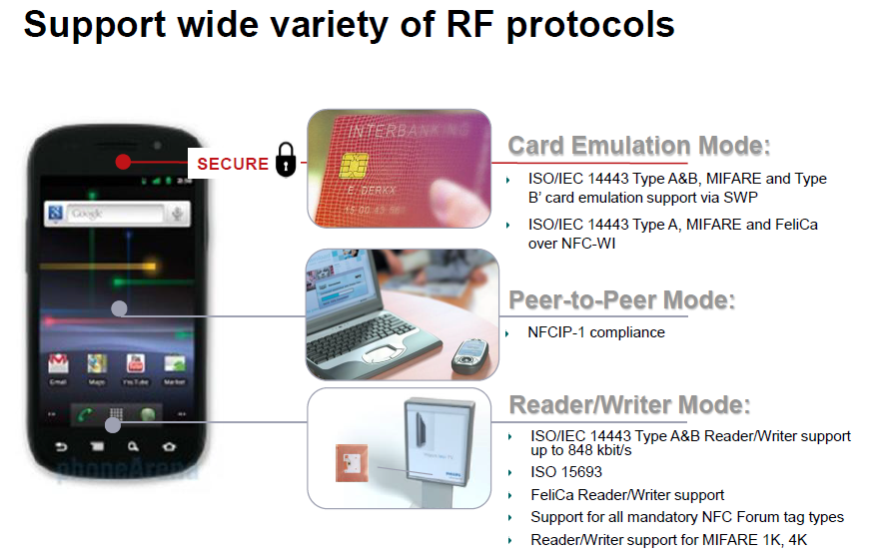
Topic1 -
NXP NFC opp in Industrial / Medical
Part#:PN5xx
424kbps
Distance:100mm
ISO14443&ISO15693

Slide 2
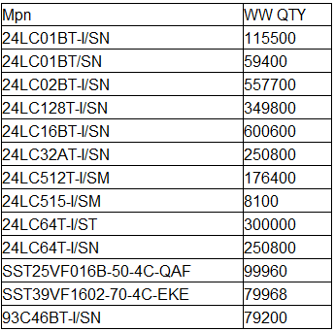
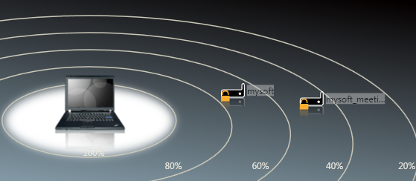
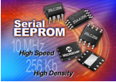
Topic2:
MCP EEPROM/Flash with good cost
Topic3:
Wireless distance detection
MCP/NXP wireless product equiped RSSI function!
What’s RSSI:
RSSI: Received Signal Strength Indication

